Slide 1
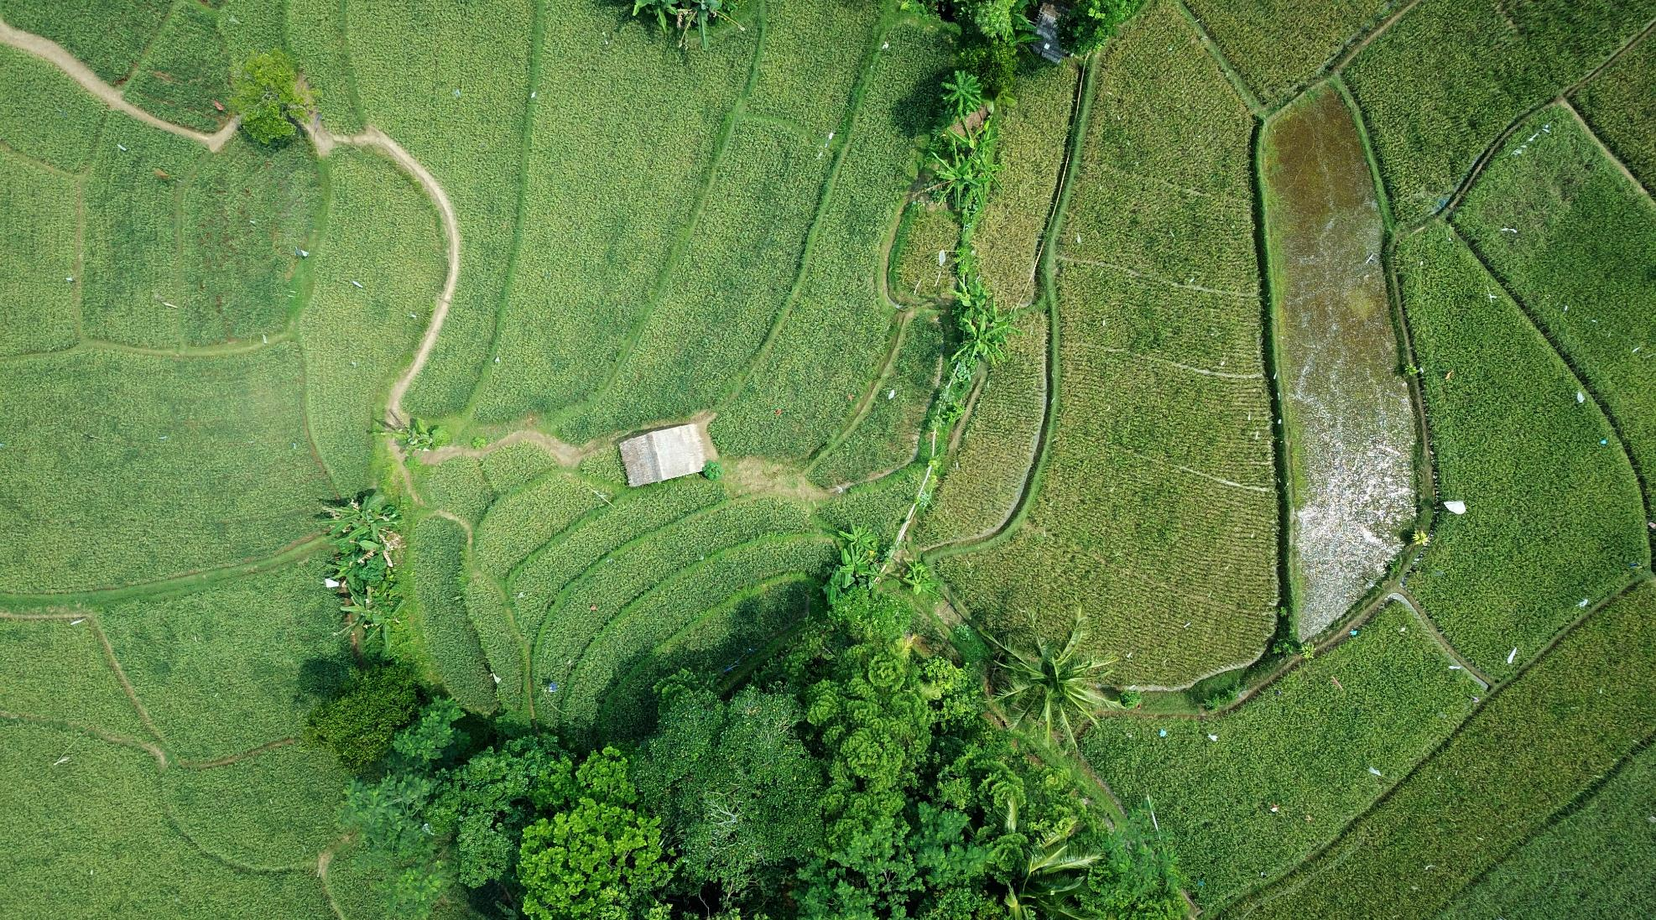

Precision Agriculture for Smart City
Team Akatsuki
Ishan Thathsara Weerakoon
Thilosha Nipunajith Gammanpila
Hasitha Gimhan Rodrigo

Slide 2
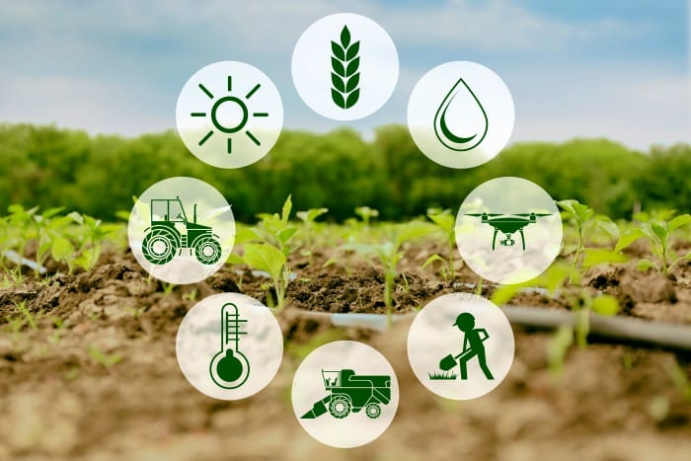
Problem ;
Next 40 years we need the same amount of food as we did for last 8000 years, and that gives a little bit of indication of the pressure on the food system. We are facing a huge challenge with growth in population with the change in consumer behavior with the climate crisis. We tried to provide a solution for your problems like how you secure your production with fewer inputs, with less fertilizer, less prestige, less water etc.

Slide 3





Methodology
Data
Gathering
Data
Clearing
Chosen the Algorithms
Train the Algorithms
AI and Platform
Satellite Images
Public Databases
QGis (Prepossessing)
Jupiter Notebook
Neural Network
Time Series
With Test Data
Keras and TensorFlow

Slide 4
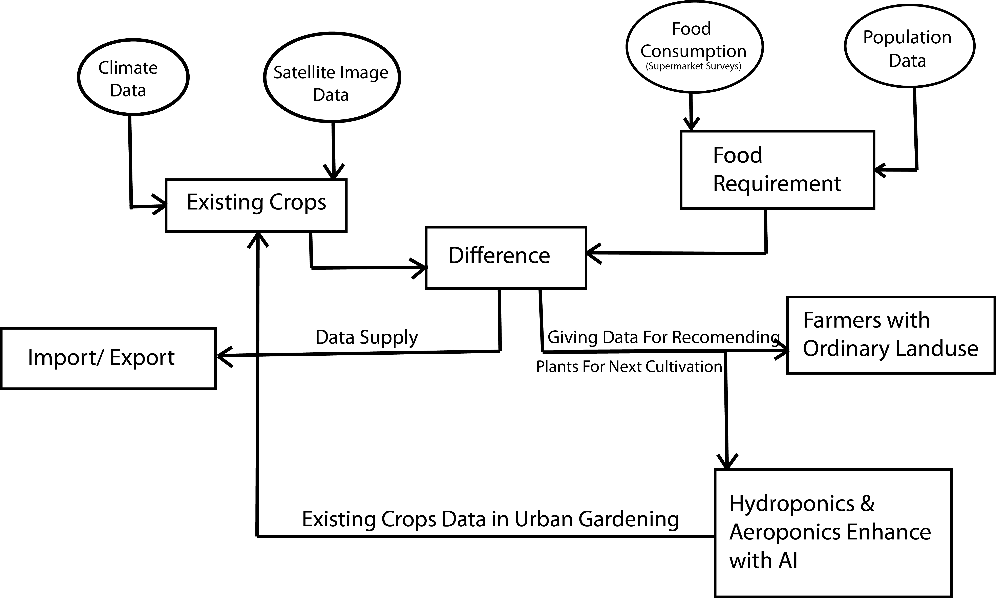



The Solution

Slide 5

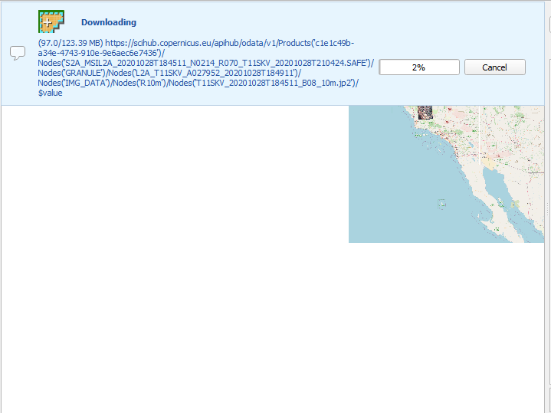

Crop Detection With Sentinel-2 Images - California
Selected Satellite → Sentinal-2
Reason →This satellite data will support
Generic land cover, land use and change detection maps
Maps of geophysical variables for leaf area index, leaf chlorophyll content, leaf water content
Index database access → https://www.indexdatabase.de/search/isearch.php?s=vegetation

Slide 6
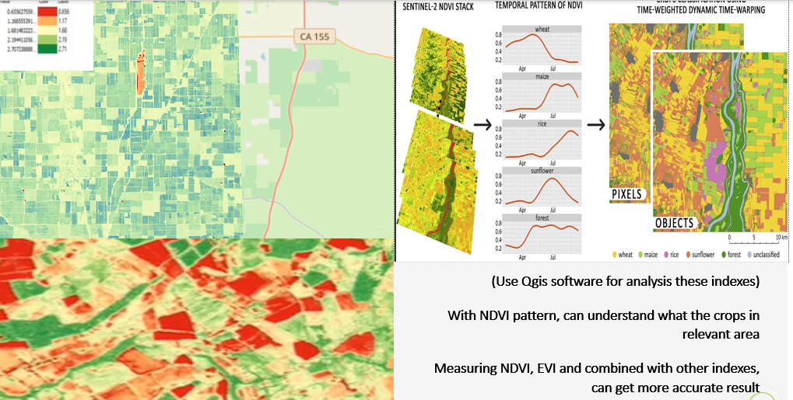
Then Calculate NDVI and EVI
NDVI (Normalized difference vegetation index)
NDVI helps to differentiate vegetation
It also allows to define and visualize vegetated areas on the map as well as to detect abnormal changes in the growth process
EVI is a vegetation index designed to give enhanced contrast in areas of dense foliage or canopy cover, making use of the blue band as well as the red and near-infrared bands used by many other indices like NDVI.

Slide 7
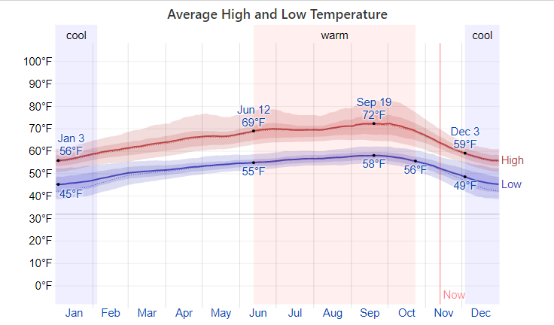
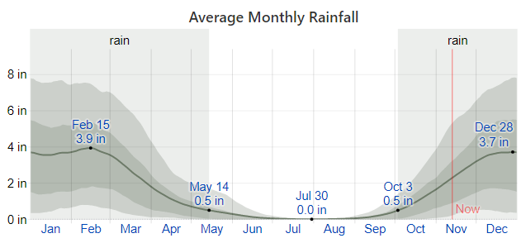
Weather Prediction with Time Series
The monthly temperature of the years 2019 & 2020 are used as primary data to predict the temperature for year.
Python is used as the machine language and Anaconda Navigator is used as the supported application.
The crops that want to grow would be selected according to the climate, rainfall, predicted temperature and solar energy throughout the year.

Slide 8
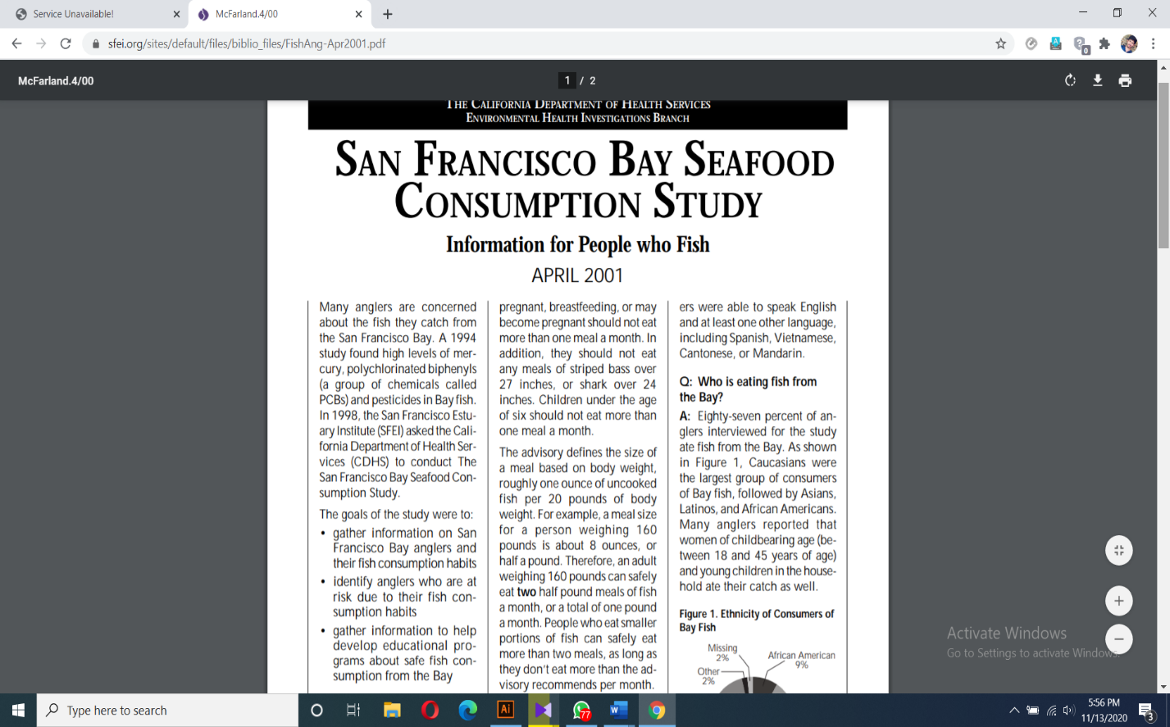
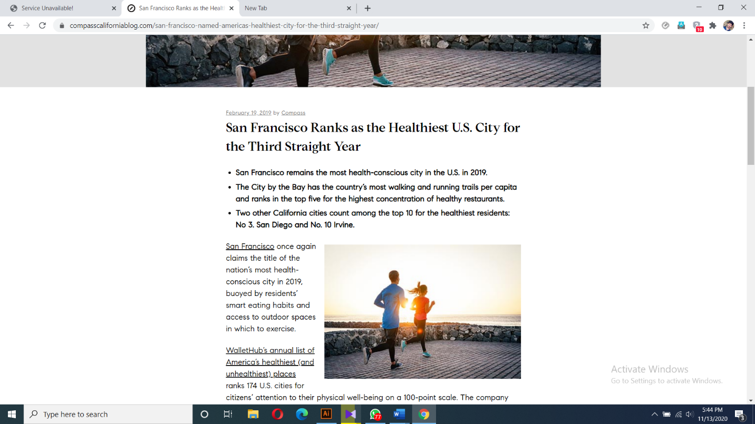
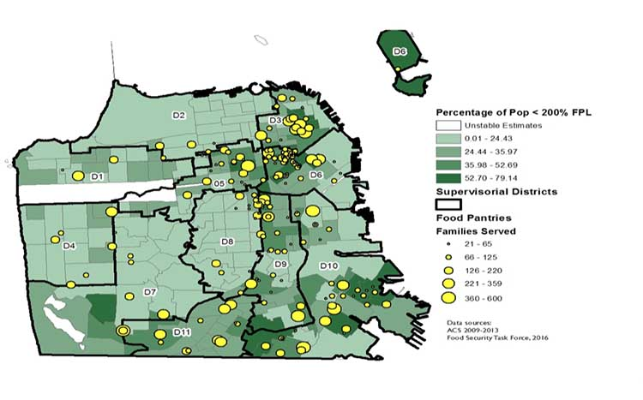
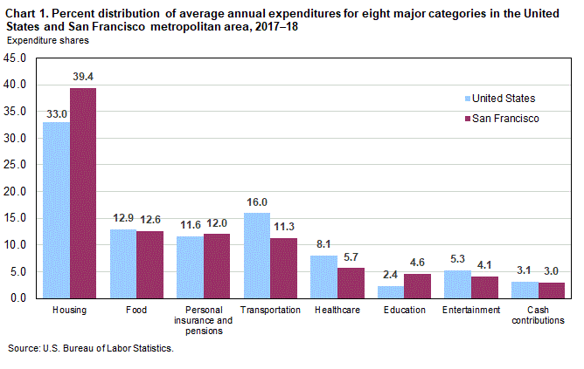
Food Consumption in San Francisco
Some ways to collect necessary data regarding this are ;
By requesting data from websites and data bases relevant to food industry
By doing surveys regarding food industry
From databases from secured sites after enabling access
By accessing databases of supermarkets, food companies, agricultural firms etc.
Click here for full article
Food Pantries Across San Francisco

Slide 9
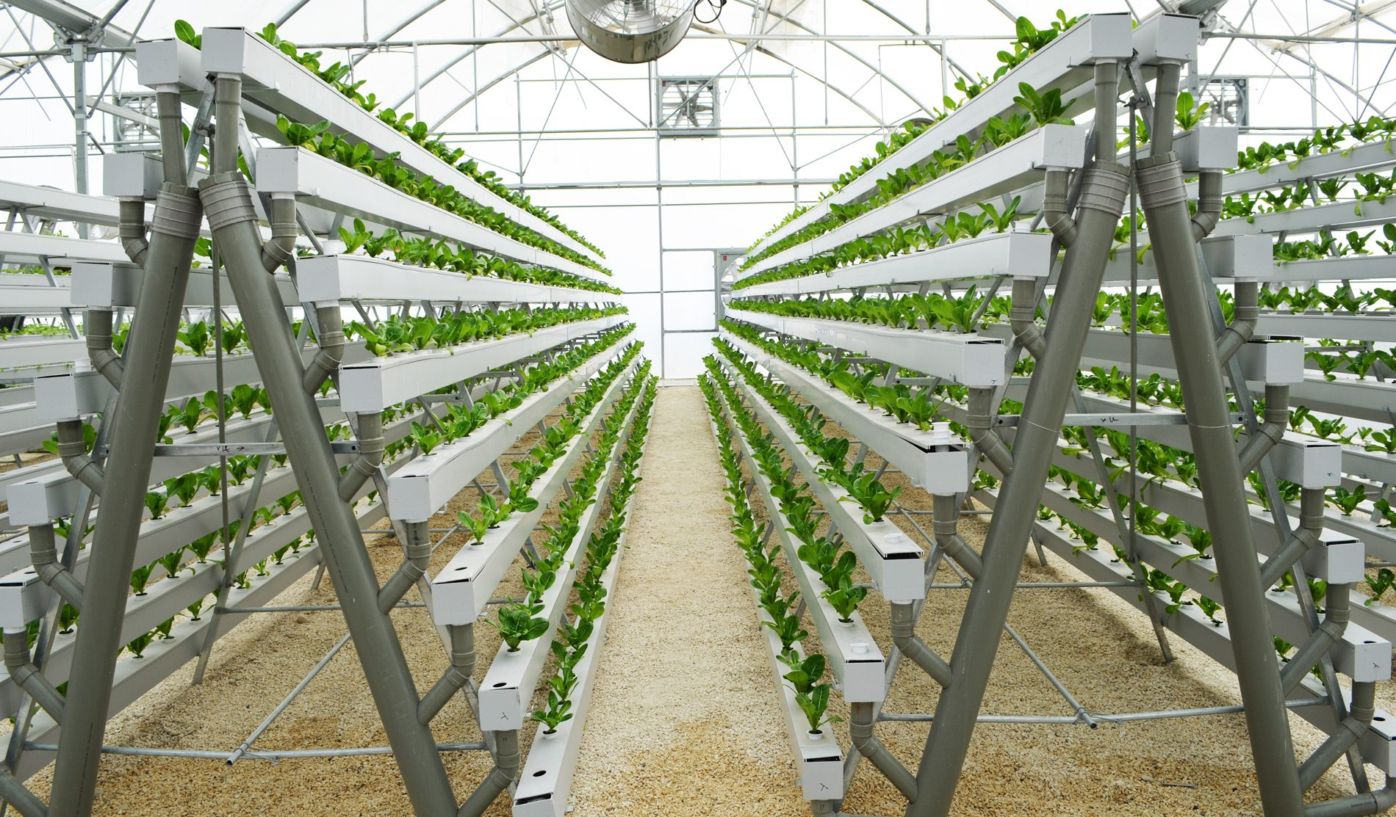


Supply and Retrieve Data From Hydroponics And Aeroponics AI Systems
Targets
Maximize harvest with vertical gardening
Support to test appropriate content for crops(In algorithm optimization area)
Use for maximizing urban productivity cultivation
Transfer data from location which plants grow healthy while supplying maximum harvest
Compare food production with outside data and recommend what want to be cultivated(with automated system)

Slide 10
Overview
The concepts of Precision Agriculture & Smart City will be essential in near future. Therefore hydroponics, aeroponics methods using AI concepts might steal the spotlight in both the agricultural and food industry. Hence for the purpose of increasing food supply according to increased populations traditional farming also has to be evolved comparing to hydroponics, aeroponics. In order to do that we gather data from all the above sections(traditional farming, aeroponics, hydroponics), and then after analysis, we provide necessary data for sustainable growth in the food supply. It will help us in achieving our target of maintaining the food chain within the selected area.

Slide 11
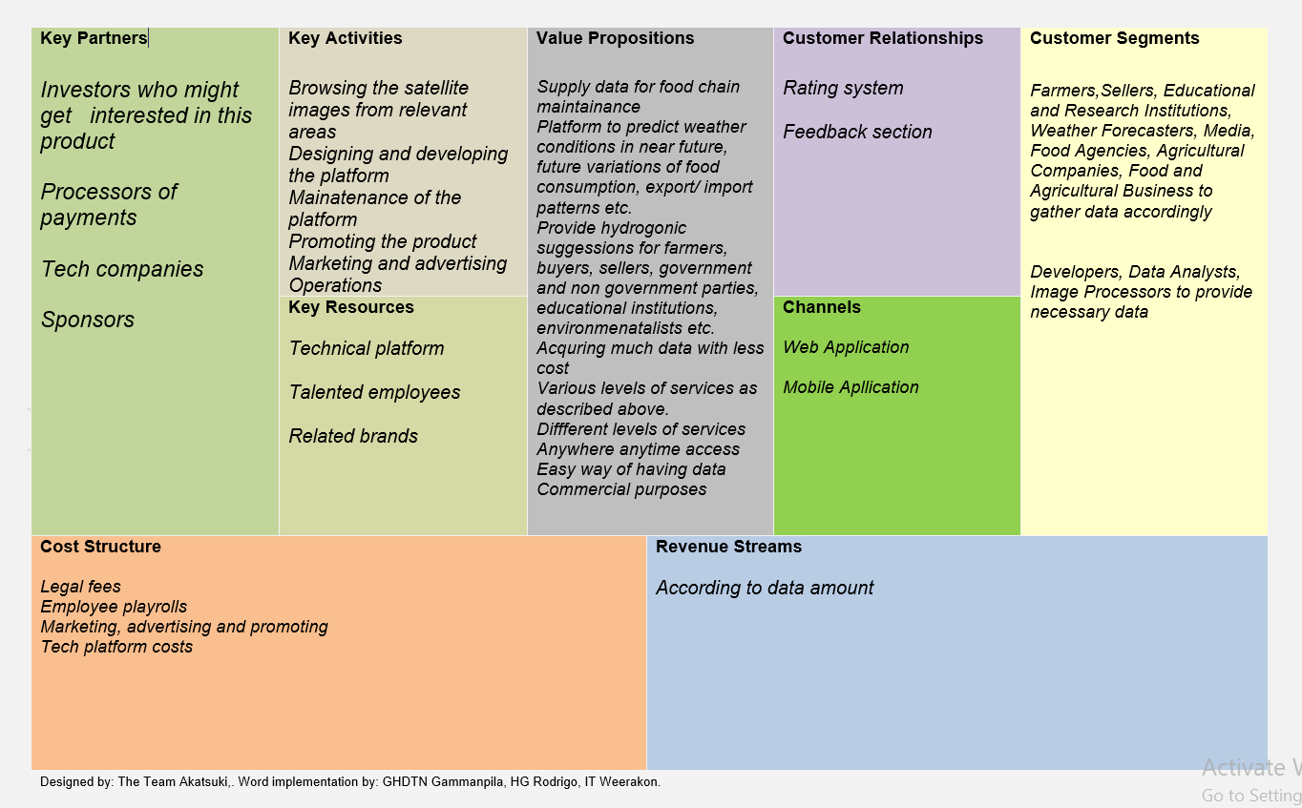
Business Model Canvas

Slide 12
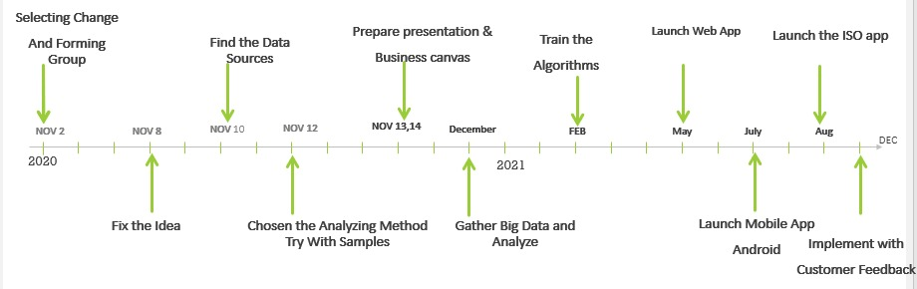
Timeline
One-year action plan

